Slide 1
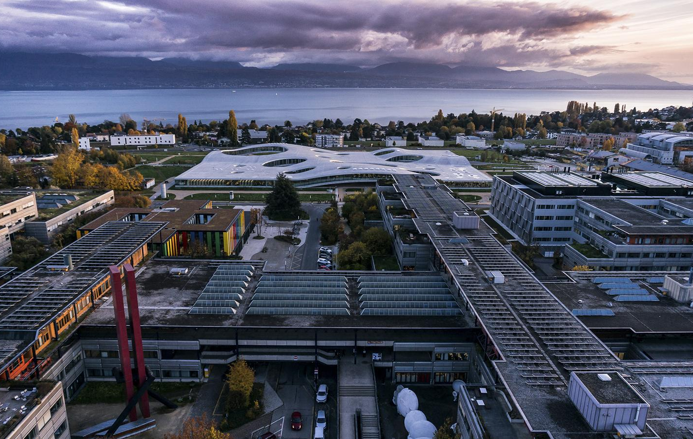
Part 2
Heat recovery
Sai Ravi, Luc Girardin,
Arthur Waeber,
François Marechal
Lausanne - 2022

Slide 2
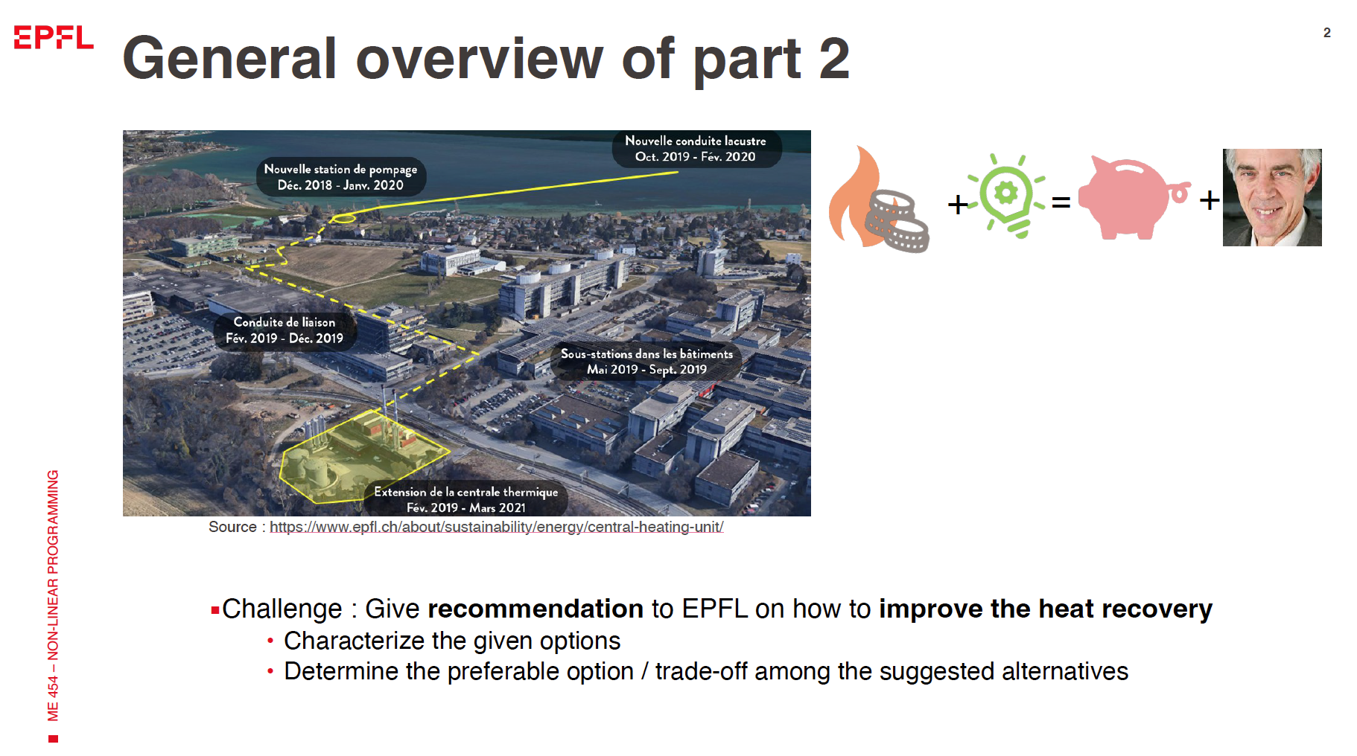

Slide 3
Project Overview
R / Python
AMPL
Building demand &
Typical Periods
MILP Scenario Evaluation
AMPL
VALI & AMPL
NLP Heat Recovery Options
Data reconciliation

Slide 4
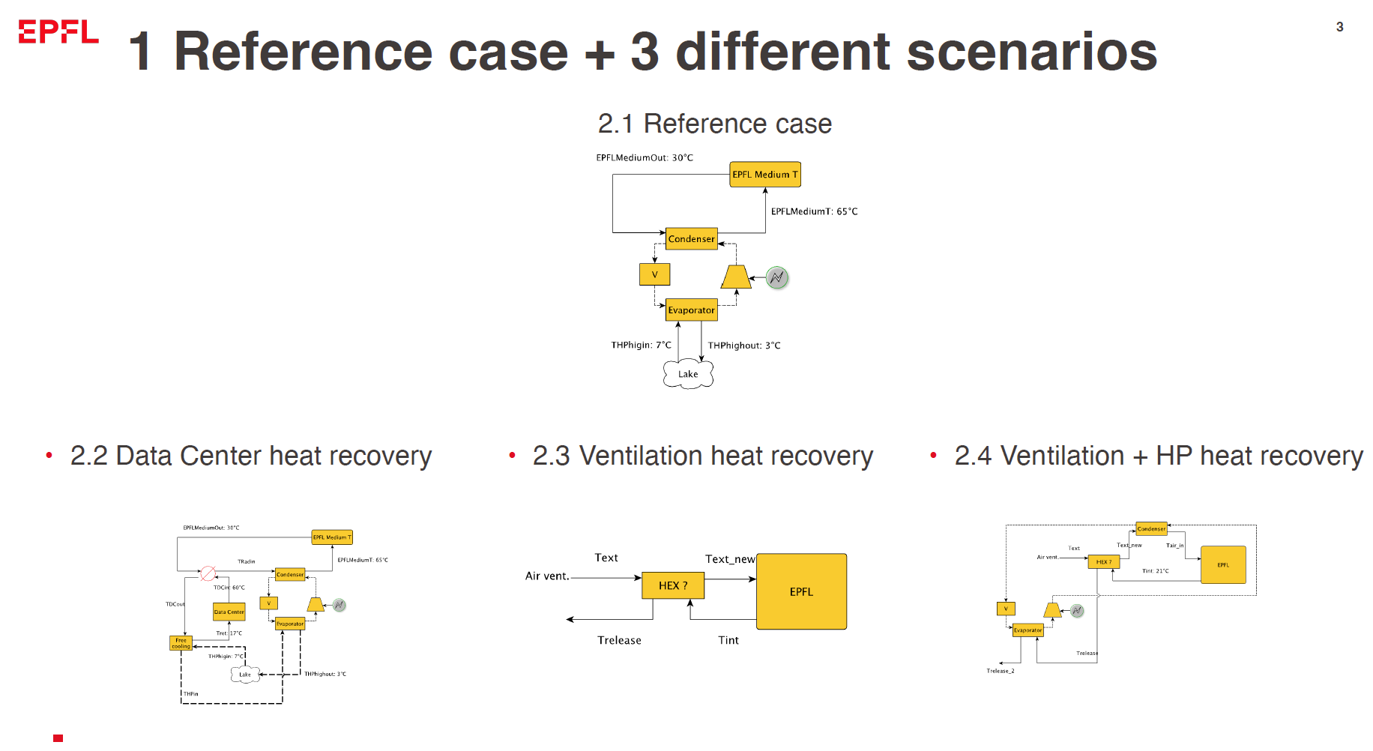

Slide 5
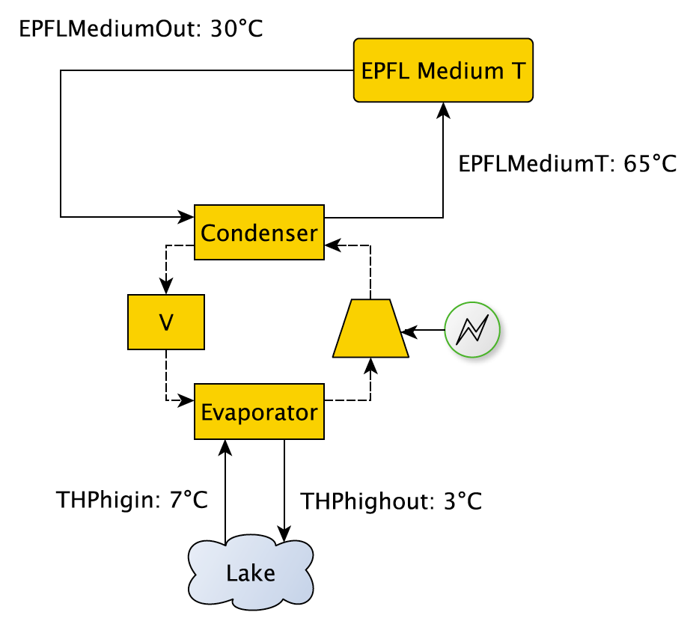
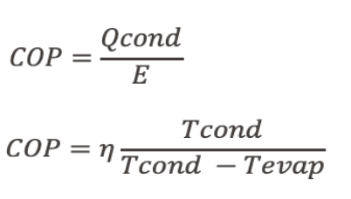
Reference case
Tasks:
Medium Temperature Heat is supplied partially by an HP that uses lake water;
What is the energy bill to supply heat to the medium temperature heating loop?
Assumptions
• All equipment in place (no investment)
• Carnot efficiency: 55%
• Lake temperature constant

Slide 6
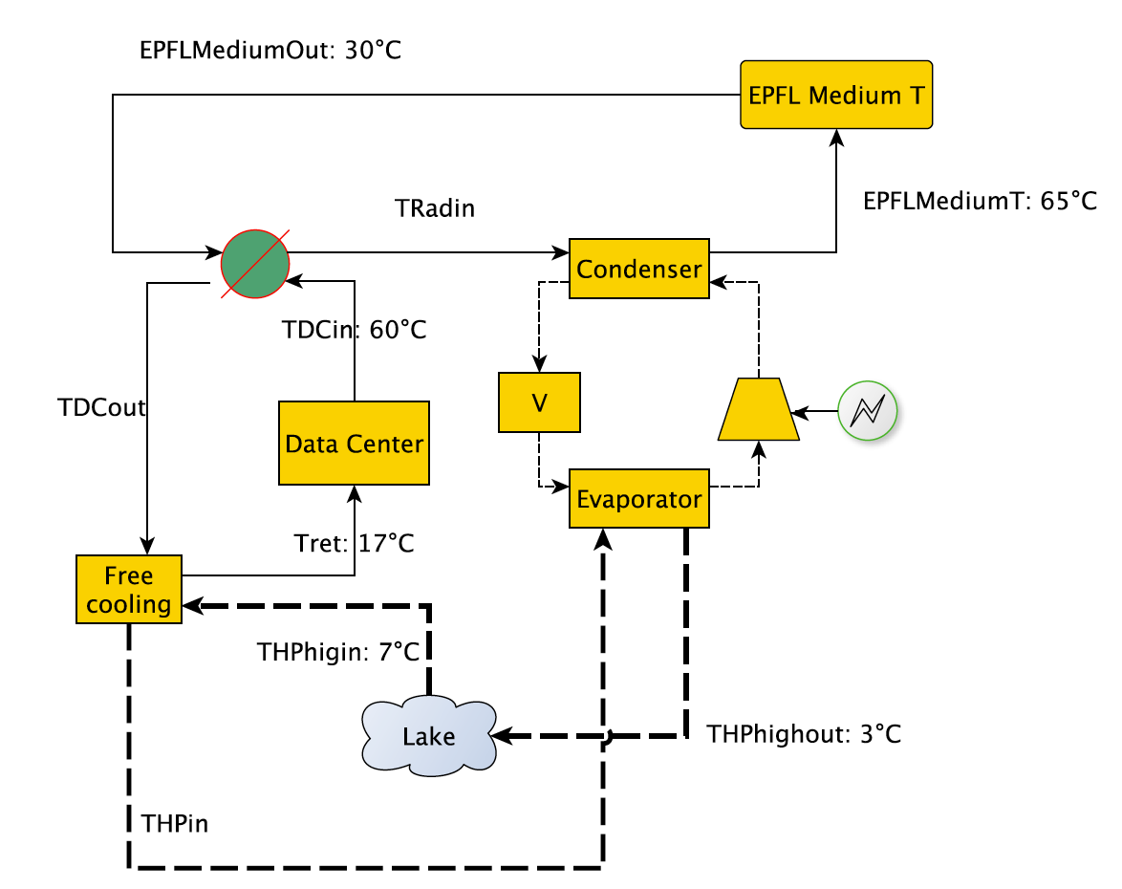
Data center
Data center HEX
Tasks:
Data Centers from EPFL need to be cooled down. What if we could reuse that heat, in a win-win situation?
Find the optimal heat exchanger size with DTmin optimization
Calculate new energy bill (if worth it)
Evaluate economic indicators
Pre-heating

Slide 7
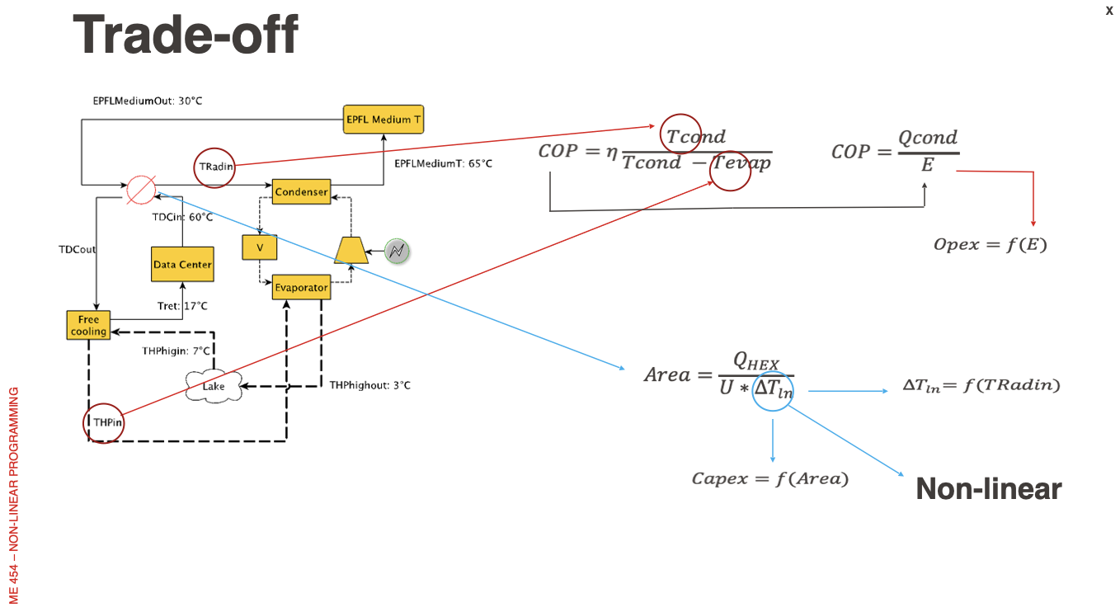

Slide 8
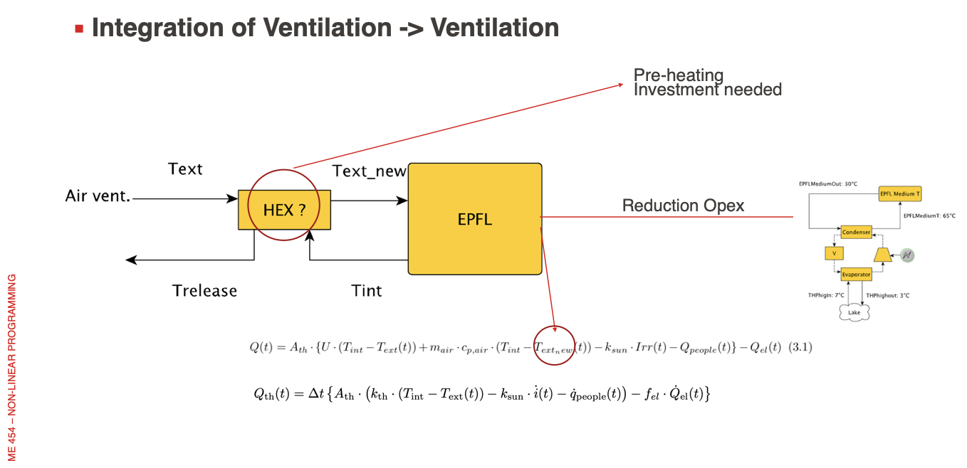

Slide 9
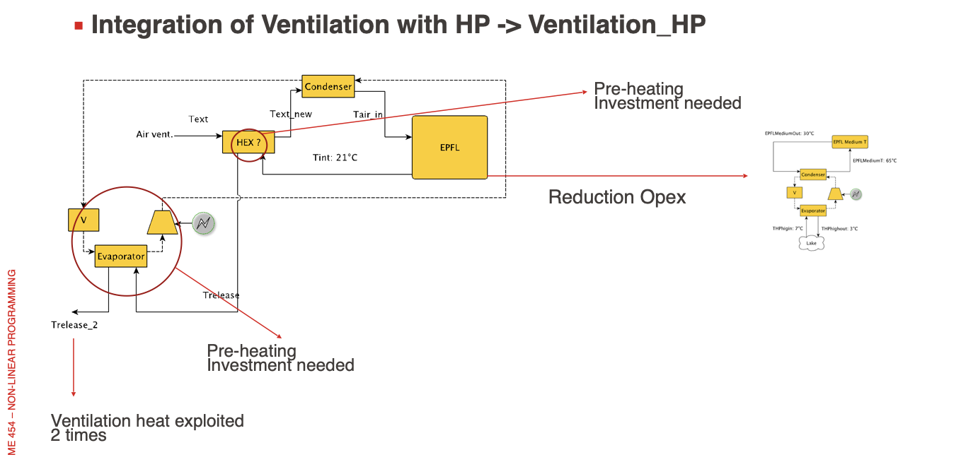

Slide 10
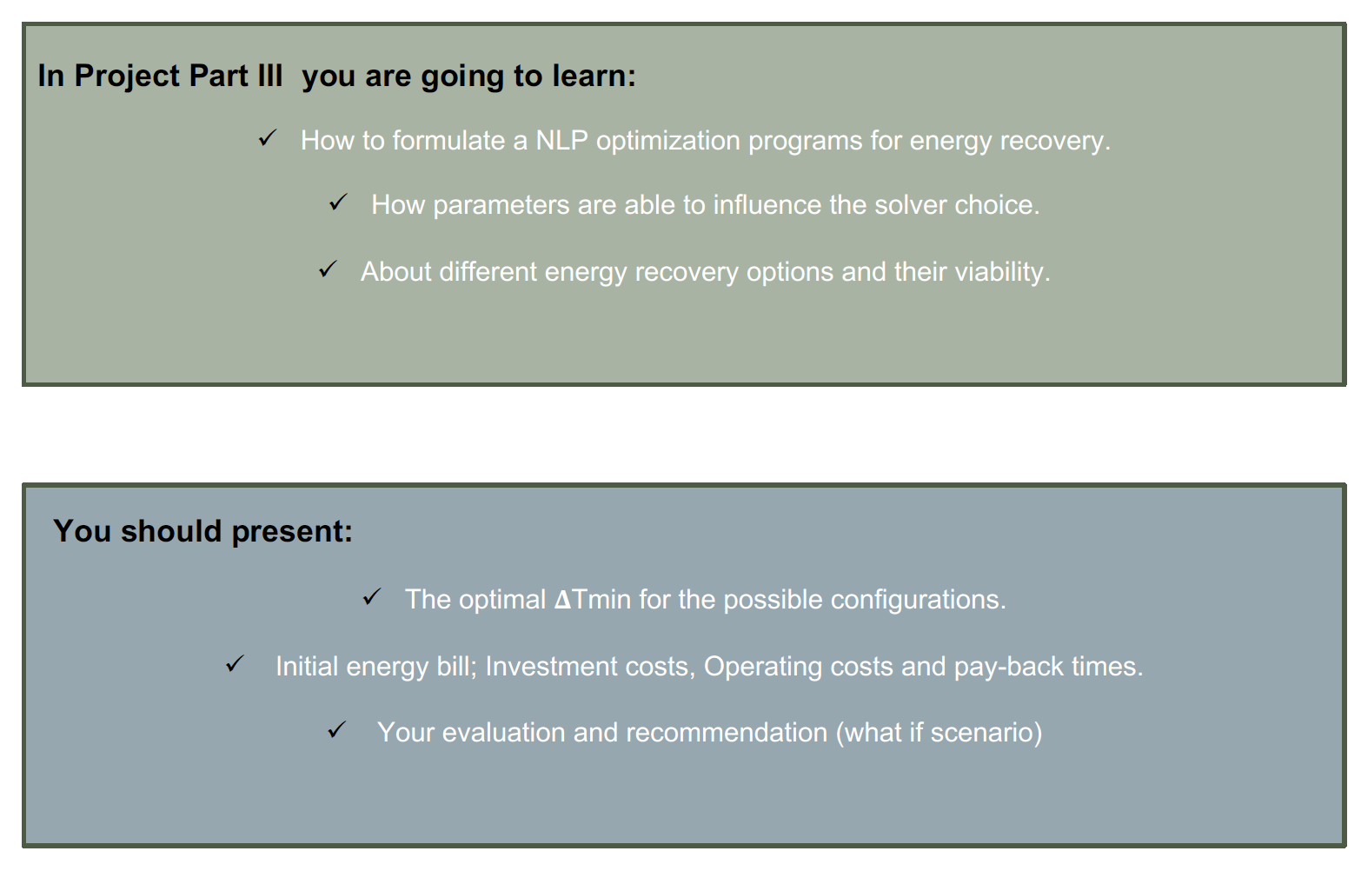
II

Slide 11
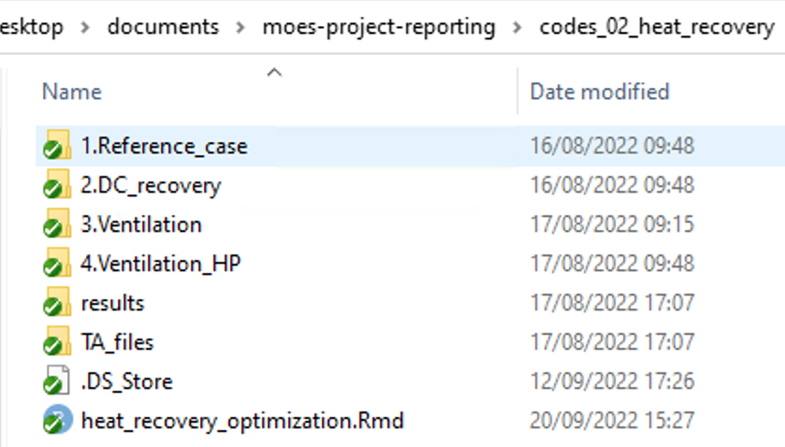
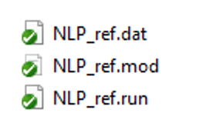
Project Files
4 heat recovery scenarios
3 ampl files per scenario: .dat = data
.mod = model
.run = run optimization

Slide 12
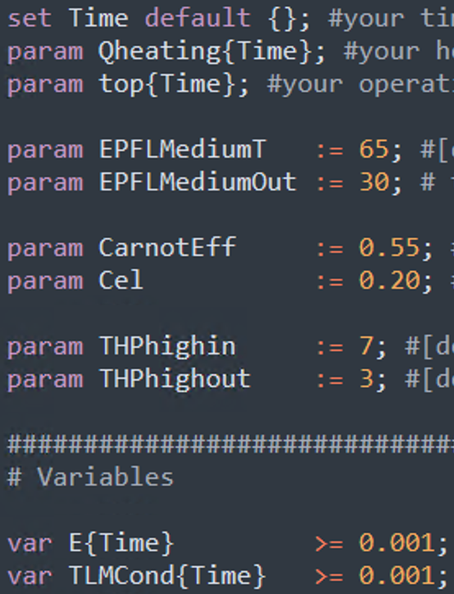
AMPL
5 main entities:
Parameters: param
Variables: var
Sets: set
Constraints: subject to
Objective function: minimize obj
Important remarks:
Parameters should have default values
Variables should have default constraints
We advise using Sublime Text 3
Don’t forget to put ; at the end of each entity

Slide 13

Merci
Cédric et Clara

